Slide 1
Travel Summary
Mexico
Hong Kong & China
India
August 2026
Notes:
This is a master template for global use, which is suitable for both internal or external use.
The order of the slide could be adjusted or deleted or added based on actual needs.
The text space and font size could be adjusted based on actual needs.
When working on each slide, please ensure the logo, page number and footnote are visible; the Title should be in Bold instead of Italics or underlined.
For external presentation, please remove the term “confidential”.
This template aims to provide the space, flexibility for all users to cater to different scenarios.

Slide 2
Mexico
Russell Bedford Mock Audit
Fixed Asset Review
Raw Material & Finished Goods Review
Notes:
This is a master template for global use, which is suitable for both internal or external use.
The order of the slide could be adjusted or deleted or added based on actual needs.
The text space and font size could be adjusted based on actual needs.
When working on each slide, please ensure the logo, page number and footnote are visible; the Title should be in Bold instead of Italics or underlined.
For external presentation, please remove the term “confidential”.
This template aims to provide the space, flexibility for all users to cater to different scenarios.

Slide 3
Zacatecas W3’s
From Russell Bedford Mock Audit
  IMMEX & PROSEC legal address incorrect
    To solve, must update PRODUCTION PROCESS, provide PHOTOS of FIXED ASSETS
  Shipping documents from the Dicex FTP shared website are missing
    To solve, create API Key between Customs Broker & Johnson Electric
      ANA software may be location where missing documents are captured; requires analysis
      Logistics Department emails may need to be scraped to recover documents

Slide 4
Zacatecas W3’s
From Fixed Asset Review
  Fixed Assets need to be identified completely, including photos of fixtures, machines, and molds, update Compliance database, and recover necessary documents
    To solve, need support from temporary employees:
      JETC students (36) to take photos and confirm Fixed Asset descriptions
      Temporary employees (5) will match physical information against Data Stage, Oracle, Actual Under Construction Assets, and Annex 24, and add to Compliance Database
      Rectification of pedimentos by JE Group MX staff
      Change regimen of pedimentos where no Fixed Asset found on plant floor
      Regularize Fixed Assets found without pedimentos

Slide 5
Zacatecas W3’s
From Raw Material & Finished Goods Review
  It was identified that Raw Materials and Finished Goods are not on the same Plant layout as Fixed Assets
    To solve, need to add Raw Materials and Finished Goods to a separate Plant layout map
      Data stage will be the basis of the information
      Import / Export / Virtual Transactions covered
      Tie back to Oracle system for balancing
      Intend to function as complete MX Customs Platform

Slide 6
Hong Kong & China
Transit Time Analysis
FCL Shipments
Americas & Europe
Notes:
This is a master template for global use, which is suitable for both internal or external use.
The order of the slide could be adjusted or deleted or added based on actual needs.
The text space and font size could be adjusted based on actual needs.
When working on each slide, please ensure the logo, page number and footnote are visible; the Title should be in Bold instead of Italics or underlined.
For external presentation, please remove the term “confidential”.
This template aims to provide the space, flexibility for all users to cater to different scenarios.

Slide 7
India
Transit Time Analysis
FCL Shipments
Americas & Europe
Notes:
This is a master template for global use, which is suitable for both internal or external use.
The order of the slide could be adjusted or deleted or added based on actual needs.
The text space and font size could be adjusted based on actual needs.
When working on each slide, please ensure the logo, page number and footnote are visible; the Title should be in Bold instead of Italics or underlined.
For external presentation, please remove the term “confidential”.
This template aims to provide the space, flexibility for all users to cater to different scenarios.

Slide 8
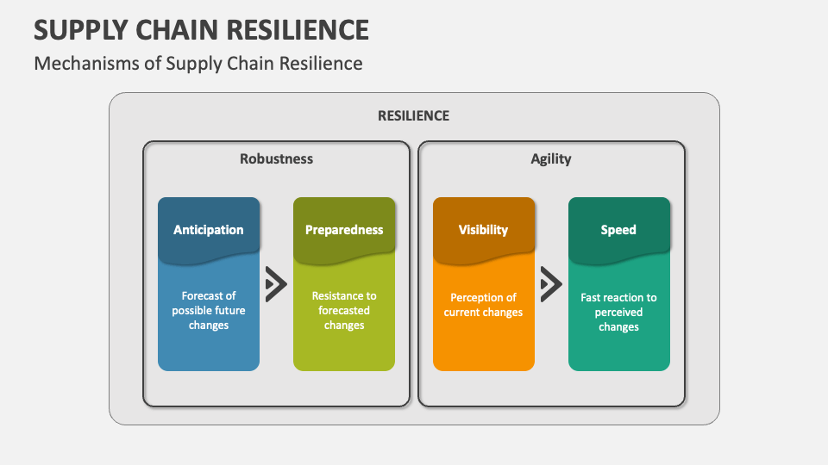
Tier-N Resiliency - Basics
Extend visibility beyond Tier-1 suppliers to Tier-2, Tier-3 and raw material sources to identify hidden supply chain risks.
Implement continuous supplier risk monitoring using digital mapping, financial health tracking and geopolitical risk assessments.
Diversify sourcing locations and critical material suppliers to reduce dependency on high-risk regions.
Currently OEMs are looking to strengthen end-to-end supplier transparency with enhanced Tier-N mapping and risk analytics.
OEMs like GM and Ford are working on moving manufacturing out of China to other hubs while tracking their entire supply chain to mitigate risks related to supply shortage.

Slide 9
Tier N Plan – Discussion 7/10/26
Housings
Steel – EG (Japan) or GI (India)
  Stamping Blanks at Chennai P603 – Feb 2027
Laminations
Sheets – SI (Japan)
  Stacks – Stamping of sheets in Chennai P601 – Feb 2027
  Open question – slitting location?
Magnets
Iron Oxide will come from Tetsugen (Japan)
Pressing at Chennai P605
  Grade 6 – October 2027
  Grade 8 – December 2027
  Grade 12 – January 2028
Shafts
Steel from India
  Forgings at Chennai P605 – October 2027

